Slide 1

MICROPROCESSOR AND COMPUTER ARCHITECTURE LABORATORY
4TH Semester(UE19CS256)
INTRODUCTION CLASS1-ARMSIM
Monday, January 18, 2021
Prof Deepti C
Computer Science and Engineering

Slide 2

MICROPROCESSOR AND COMPUTER ARCHITECTURE LABORATORY
Team of Faculty Members
RR Campus:
Prof Roopa Ravish
Prof Supriya. M
Prof Raghu B. A Rao
Prof Chitra G.M
Prof Chandravva Hebbi
Prof Revathi G. P
Prof Suresh
Prof Samantha
EC Campus:
Dr Kiran. D. C.
Prof Shanthala P.T
Prof Deepti. C.
Prof. Anantanagu
Prof. Suchitra
Department of Computer Science and Engineering

Slide 3
Microprocessor & Computer Architecture Laboratory
UE19CS256
Evaluation Policy- (ISA)
Evaluation Policy- (ESA)
Sl. No | Components | Marks
1 | Conduction (Regular Lab-Weekly) | 30
2 | Quiz1 (1 week before ISA1) | 10
3 | Viva (1 week before ESA) | 10
 | Total | 50
Sl. No | Components | Marks
1. | Quiz | 20
2. | Project Demo | 20
3. | Project Report | 10
 | Total | 50
Department of Computer Science and Engineering

Slide 4
Microprocessor & Computer Architecture Laboratory
Course Information
WEEK 1 | Write an ALP using ARM instruction set to add and subtract two 32 bit numbers .Both numbers are in registers. Write an ALP to demonstrate logical operations. All operands are in registers. Write an ALP to add 5 numbers where values are present in registers. Write an ALP using ARM instruction set to check if a number stored in a register is even or odd. Write an ALP to compare the value of R0 and R1, add if R0 = R1, else subtract Write an ALP to find GCD of two numbers (without using LDR and STR instructions).Both numbers are in registers.
WEEK 2 | Write an ALP to add two 16 bit numbers loaded from memory and store the result in memory. Write an ALP to copy n numbers from Location A to Location B. Write an ALP to find the factorial of a number stored in R0. Store the value in R1 (without using LDR and STR instructions) Write an ALP to find the GCD of given numbers (both numbers in memory).Store result in memory. Write an ALP to add an array of ten 32 bit numbers from memory. Add array of ten 16 bit numbers taking data from memory location stored as byte data (use .byte to store the data instead of .word)
WEEK 3 | Generate Fibonacci Series and store them in an array. Write an ALP to find smallest number in an array of n 32 bit numbers A) To perform Convolution using MUL instruction (Addition of multiplication of respective numbers of loc A and loc B) B) To perform Convolution using MLA instruction (Addition of multiplication of respective numbers of loc A and loc B). Write an ALP to find mul (add( a,b),c) Write an ALP to find factorial using subroutine Write an ALP to perform multiplication using shift method (without using MUL)

Slide 5
Microprocessor & Computer Architecture Laboratory
UE19CS256
Course Information
WEEK 4 | Write an ALP to add two 16 bit numbers loaded from memory and store the result in memory. Write an ALP to copy n numbers from Location A to Location B. Write an ALP to find the factorial of a number stored in R0. Store the value in R1 (without using LDR and STR instructions) Write an ALP to find the GCD of given numbers (both numbers in memory).Store result in memory. Write an ALP to add an array of ten 32 bit numbers from memory. Add array of ten 16 bit numbers taking data from memory location stored as byte data (use .byte to store the data instead of .word)
WEEK 5 | Write an ALP to implement B=a[i][j] Write an ALP to implement C[k]=a[i]+b[j] Write an ALP to implement Sum[i]+=a[i][j]
WEEK 6 | Write an ALP to find the length of a given string Write an ALP to copy string from one location to another Write an ALP to find whether a given character is present in a string. Write an ALP to find how many times a given character is present in a string
Department of Computer Science and Engineering

Slide 6
Microprocessor & Computer Architecture Laboratory
UE19CS256
Course Information
WEEK 7 | Hardware Programming
WEEK 8 | Hardware Programming
WEEK 9 | Hardware Programming
WEEK 10 | Pipelining
WEEK 11 | Pipelining
WEEK 12 | Hazards and their Solutions
Department of Computer Science and Engineering

Slide 7

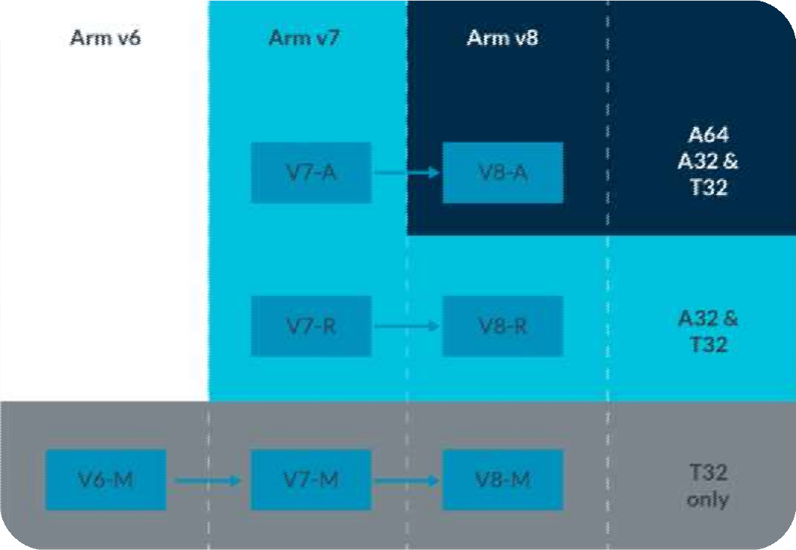
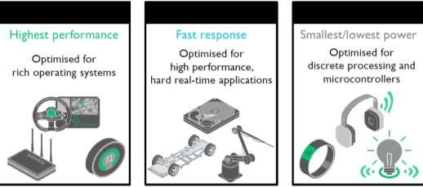
Architecture Profile
A
(Architecture)
M
(Microcontroller)
Images courtesy https://developer.arm.com/architectures/instruction-sets
Department of Computer Science and Engineering

Slide 8
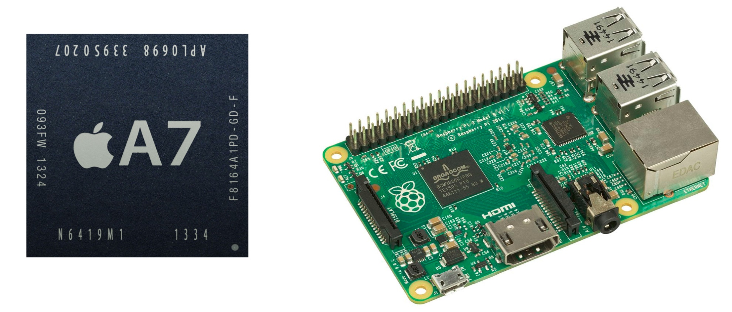
The Apple A7 and Raspberry Pi both use implementations of the Armv8 architecture. Images courtesy of Wikipedia's Apple_A7 and Raspberry_Pi articles.
Department of Computer Science and Engineering

Slide 9

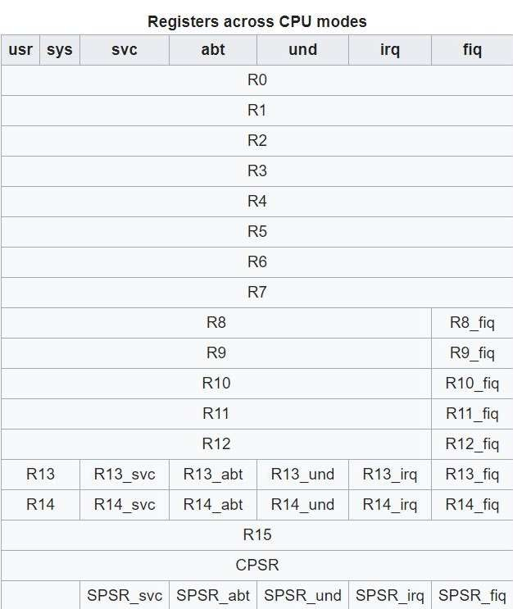
ARM REGISTERS
Department of Computer Science and Engineering

Slide 10
FORMAT OF ARM INSTRUCTIONS
MNEMONIC{S} {condition} {Rd}, Operand1, Operand2
Where, MNEMONIC : Short name of the instruction
{S} : An optional suffix. If S is specified, the condition flags are updated on the result of the operation.
{Condition} : Conditions that has to be met for the execution of the instruction.
{Rd} : Destination of the register for storing the output of the instruction.
Operand1 : First register (either can be a register or an immediate value).
Operand2 : Second (Flexible) operand (can be a register or an immediate value with a level of shift).
Department of Computer Science and Engineering

Slide 11
MNEMONICS IN ARM
Instruction | Description | Instruction | Description
MOV | Move data | POP | Pop on stack
ADD | Addition | SUB | Subtraction
MUL | Multiplication | LSL | Logical shift left
LSR | Logical shift right | ASR | Arithmetic shift right
ROR | Rotate right | CMP | Compare
AND | Bitwise AND | ORR | Bitwise OR
EOR | Bitwise XOR | LDR | Load
STR | Store | LDM | Load multiply
STM | Store multiply | PUSH | Push on stack
B | Branch | BL | Branch with link
BX | Branch with exchange | BLX | Branch with link and exchange
SWI/SVC | System call | MVN | Move 2’s complement
Department of Computer Science and Engineering

Slide 12
INSTRUCTION EXAMPLES
Rx, LSR n | Register x with logical shift right by n bits (1 = n = 32)
Rx, RRX | Register x with rotate right by one bit, with extend
ADD R0, R1, R2 | Adds contents of R1 (Operand1) and R2 (Operand2 in a form of register) and stores the result into R0 (Rd).
MOVLE R0, #5 | Moves number 5 (Operand2, because the compiler treats it as MOVE R0, R0, #5) to R0 (Rd) ONLY if the condition LE (Less Than or Equal) is satisfied.
Department of Computer Science and Engineering

Slide 13

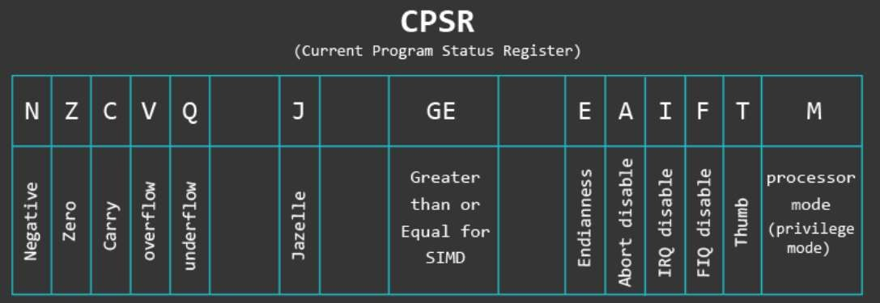
Department of Computer Science and Engineering

Slide 14
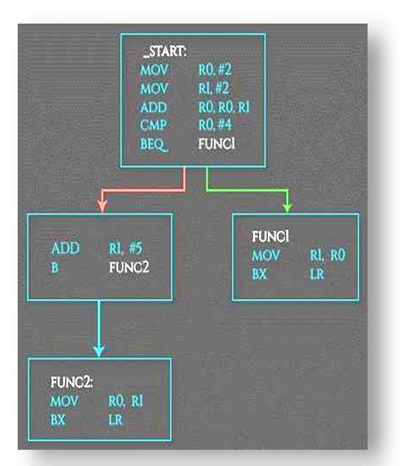
CONDITIONAL EXECUTION
Branches can also be executed conditionally and used for branching to a function if a specific condition is met.
Condition Code | Meaning (for cmp or subs) | Status of Flags
EQ | Equal | Z==1
NE | Not Equal | Z==0
GT | Signed Greater Than | (Z==0) && (N==V)
LT | Signed Less Than | N!=V
GE | Signed Greater Than or Equal | N==V
LE | Signed Less Than or Equal | (Z==1) || (N!=V)
CS or HS | Unsigned Higher or Same (or Carry Set) | C==1
CC or LO | Unsigned Lower (or Carry Clear) | C==0

Slide 15
LOAD AND STORE
ARM uses Load-store model for memory access
On ARM data is must be moved from memory into registers before being operated on.
This means that incrementing a 32-bit value at a particular address into register, increment it within the register, and store it back to the memory from register.
Department of Computer Science and Engineering

Slide 16
BRANCHES
Branches (Jumps) allow us to jump to another code segment. This is useful when we need to skip (or repeat) blocks of codes or jump to a specific function. Best examples of such a use case are IFs and Loops.
There are three types of branching instructions:
Branch (B)
Simple jump to a function
Branch link (BL)
Saves (PC+4) in LR and jumps to function
Branch exchange (BX) and Branch link exchange (BLX)
Same as B/BL + exchange instruction set (ARM <-> Thumb)
Needs a register as first operand: BX/BLX reg
Department of Computer Science and Engineering

Slide 17
ARMSIM
ARMSim is a desktop application, it allows users to simulate the execution of ARM assembly language programs on a system based on the ‘ARM7TDMI’ processor.
ARMSim includes both an assembler and a linker. When a file is loaded, the simulator automatically assembles and links the program However editor is not there, so file must be loaded into the application.
The file to be opened must be a source (.s) file or an object (.o) file.
The window of ARMSim# program can be divided into three parts; code view (displaying code), stack view (displaying stacks) and register view (displaying 16 general purpose registers).
Department of Computer Science and Engineering

Slide 18
ARMSIM INSTALLATION ON WINDOWS
ARMSim# version 2.1 for Windows
https://webhome.cs.uvic.ca/~nigelh/ARMSim-V2.1/Windows/index.html
https://www.youtube.com/watch?v=roJ7D9wMyOk
Windows Installer Download and execute this file using an account with Administrator privileges: Installer.msi
Department of Computer Science and Engineering

Slide 19
ARMSIM INSTALLATION ON LINUX
https://webhome.cs.uvic.ca/~nigelh/ARMSim-V2.1/Linux/ArmSimOnLinuxInstall.pdf
ARMSim# version 2.1 for Mac OS X
Unfortunately ARMSim# no longer works on Mac OS X.
The best alternatives are to either set up BootCamp on the Mac to run Windows (and use the Windows version of ARMSim# of course),
or install virtual machine software to provide Linux or Windows as the guest operating system.
Department of Computer Science and Engineering

Slide 20
LAB 1: Introduction to ARM Simulator
Running the First ARM Assembly Language Program
Your first assembly program adds two numbers. The numbers, 3 and 5, are assumed to be in register 0 and register 1, respectively, while the result is to be stored in the memory location whose address is in register 3.
Department of Computer Science and Engineering

Slide 21
First assembly program
MOV R0,#3 @ Move the value 3 into register R0
MOV R1,#5 @ Move the value 5 into register R1
MOV R3,#0x3000 @ Move the address of the result into R3
ADD R2, R0, R1 @ Add the content of R0 and R1, keep result in R2
STR R2,[R3] @ Store the content of R2 at the address in R3
.END
Department of Computer Science and Engineering

Slide 22
Follow the steps below to run the above program in ARMSim#:
(i) Write the program in note or text pad and save as .s (source) or .o (object) extension.
(ii) Open the simulator and select File.
(iii) Choose Load by specifying the location of your file and the file will be executed automatically.
(iii) You can view the content of the registers that you used in the program in the left side of your working window or register view area
Department of Computer Science and Engineering

Slide 23
THANK YOU
Deepti C
Department of Computer Science and Engineering
deeptic@pes.edu

